Slide 1
Storyboarding 2.0
Guidelines
June 23, 2017

Slide 2
Agenda
Why Storyboarding
Phase 1:
Phase 2:

Slide 3
Storyboarding is a visual aid that makes it easier for you to share and explain your vision with others
Why?
Origin
The storyboarding process, in the form it is known today, was developed at Walt Disney Productions during the early 1930s, after several years of similar processes being in use at Walt Disney and other animation studios
Serves as a blueprint outline of the design approach
Defines elements that need to be stitched together to form an engaging story
Shows the navigational architecture and information flow to the team
Demonstrates how the flow will work together to provide the user’s interactive experience
Purpose
Best way to share a vision: Provides stakeholders the experience of visualizing something off of a text deliverable, such as a script
Simplifies creation process: Structured plan to create through suggested thoroughline helps piece information together according to our vision
Saves time: Front loaded thought on detailed structure helps minimize iterations
Benefits

Slide 4
Effective storyboarding is a two-phased approach that begins with visualization of the design followed by creation
How?
Figure out what you want to achieve, understand the context and the audience for whom it is designed & flesh out the outline of your story
Dream the design:
Phase I
Message design
Empathy Map to understand your audience
Meeting OBI to customize story to your audience
Pyramid principle to structure & create the story
Creating the slides that tell your story in the most effective and appropriate way
Make it real:
Phase II
Slide design
Simplicity in messaging
Usage of appropriate charts & aesthetic appeal
The Mu Sigma Way

Slide 5
Flow of Storyboarding Phase 1
Understanding Client
(Empathy Map)
Defining the problem
(muPDNA)
Meeting Expectations
(OBI)
Providing Recommendations
to Client
Providing
Solution
(Model/Dashboard)
Testing Hypothesis
(EDA)

Slide 6
The story needs to flow logically in a horizontal and vertical fashion to engage the audience better
Characteristics of Storyboard
Horizontal logic:
Vertical logic:
Structured & logical approach to answer Business User’s questions
Question – answer dialogue
Deductive Reasoning: Premises of an argument supports the conclusion but do not ensure it. Each of the elements answers a question (e.g. why, how, how do you know) about the thesis above it
Inductive Reasoning: Conclusion is necessitated by previously known facts. One element logically leads to the next
People are usually disinterested in something they already know and are interested in finding out what they do not know
When a person hears something they do not know, it leads to questions. This would lead to the question-answer dialogue between you and the Business user, which engages them more with your presentation

Slide 7
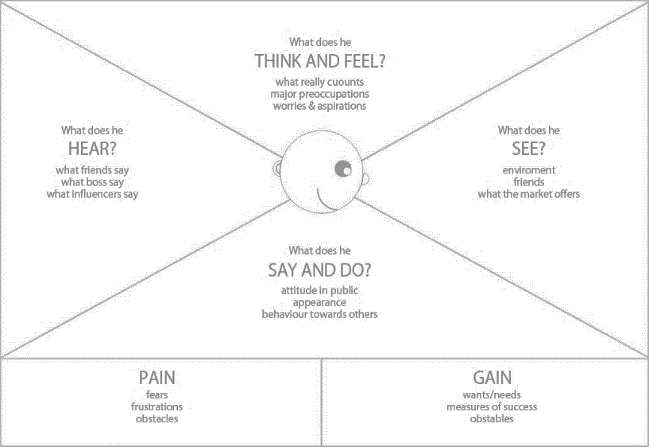
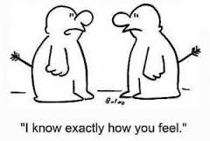
Empathy Map is a collaborative tool to help gain a deeper insight into our customers
“A good design is grounded in a deep understanding of the person for whom we design”
Understanding & connecting with customer needs & goals is a key imperative behind success of any idea
Understand customers helps us empathize with them by getting to know their environment, their aspirations, their concerns and their daily routines
The customer profile built leveraging this helps one to design value propositions, channels of contact and the most appropriate customer relationship

Slide 8
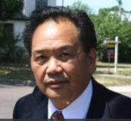
Who is Mark Xang?
Example
Illustration
He is very focused on delivering results. Tries to get to the point fast- cut the chase get to the point
He is not comfortable with high investment changes to the current strategy since it would showcase his initial plan as a failure
He hears about Michael’s lowering confidence in him due to the adverse performance of his brand
Mu Sigma is good at number crunching but has limited capabilities in providing business and strategic insights
Competition has introduced supplementary products at reduced prices
Opportunity for growing data analytics within the org
He is an analyst at heart and likes to go into details
He believes in working as per an action plan
Fears/Pain points/Obstacles
Wants, Needs, Success measure
Data privacy & security is a bother as many issues were raised by compliance team in the past
His team still follows legacy practices is slow to adapting for change
Wants Mu Sigma to showcase use of latest analytical tools and practices
Delivering timely insights to business is something which he sees as key to make big difference in decisions and revenues
Notes:
Should be doing this exercise for AL/SDS/2013 batch only as of now – helpful in gaining context in appraisal discussions at the end of year
Need to find a way to integrate with goals

Slide 9
In the context of storyboarding, OBI serves as a powerful mechanism to help structure your presentation
“Once you know where you are and where you are going, it's relatively easy to get there”
Design
Description
O
Outcomes
What would you like to accomplish from the presentation?
B
Behaviors
What are the actions within your control that will help achieve these outcomes during the presentation?
I
Insights
What are key notables from the analyses that will help trigger desired behaviors?
Note: Different outcomes must have different OBIs.

Slide 10
Sample meeting OBI
Example
Illustration
Outcome 1
What would you like to accomplish from the presentation w.r.t. the problem
Behavior: What are the actions within your control that will help achieve these outcomes during the presentation
Insights: What are key notables from the analyses that will help trigger desired behaviors?
Outcome 2
What would you like to accomplish from the presentation w.r.t. AOPS approach
Behavior: What are the actions within your control that will help achieve these outcomes during the presentation
Insights: What are key notables from the analyses that will help trigger desired behaviors?

Slide 11
Checklist for storyboard phase1
Empathy Map (Should contain the essence of what is provided in the question)
Meeting OBI (Should clearly state the expected outcomes and behavior in the meeting)
muPDNA - SGQ needs to be read and modified if needed (Use the latest template as per AOPS website)
Storyboard
Read all the muSearch links to understand the key terminologies and context of the problem (Do a research if muSearch is not provided)
Perform EDA on the selected hypothesis and identify all relevant metrics which would help to solve the problem
Provide a solution to the problem for which client has approached Mu Sigma (Model/Dashboard/Report)
Create relevant visuals/charts for EDA performed and the solutions provided
Provide recommendations based on your results or future steps
Note:
Story should follow horizontal and vertical logic as described earlier
Empathy map, meeting OBI, muPDNA should be present in the deck whereas story should be represented in handwritten format (embedded in the deck) only.

Slide 12
Flow of Storyboarding Phase 2
Executive Summary
Approach and Methodology
Problem Design
Appendix
Recommendations/Next Steps
EDA and results

Slide 13
Storyboard phase-2- Important Points
Mu sigma color codes followed for the images/icons/cliparts/graphs, if used, as well preferably
Text-boxes are NOT inserted on top of shapes for writing content
Agenda slide present only once preferably with appropriate Slide headers present throughout? No Chevrons.
Mu Sigma Logo? With proper alignment and consistency?
Font size is maintained. Preferably 14/12 point
Font style - Preferably Arial. Calibri/Segoe UI is acceptable but should be consistent throughout
No shadows to be used anywhere in the deck
All the talking headers should be aligned
REFER TO CHECKLIST DOCUMENT SHARED WITH COURSE CONTENT

Slide 14
Thank You

