Slide 1
BSH Chat on Model Management
muOPS-AI
2018

Slide 2
Agenda
Why Deploying Intelligence is Important
muOPS-AI Offering (Beta)
Asks:
If you see an opportunity for a Model Ops program - we have an offering - lets get involved at a minimum as a trusted partner
Joint development of muOPS-AI is possible

Slide 3
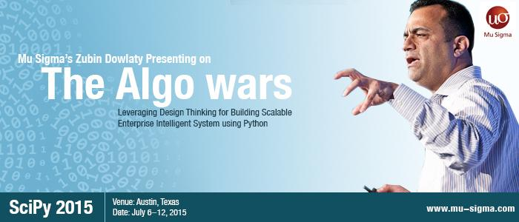
Why is this important?
Algo Wars are Coming to your Industry
Be Prepared to Compete on your Information Processing Capability…
Computational Propaganda

Slide 4
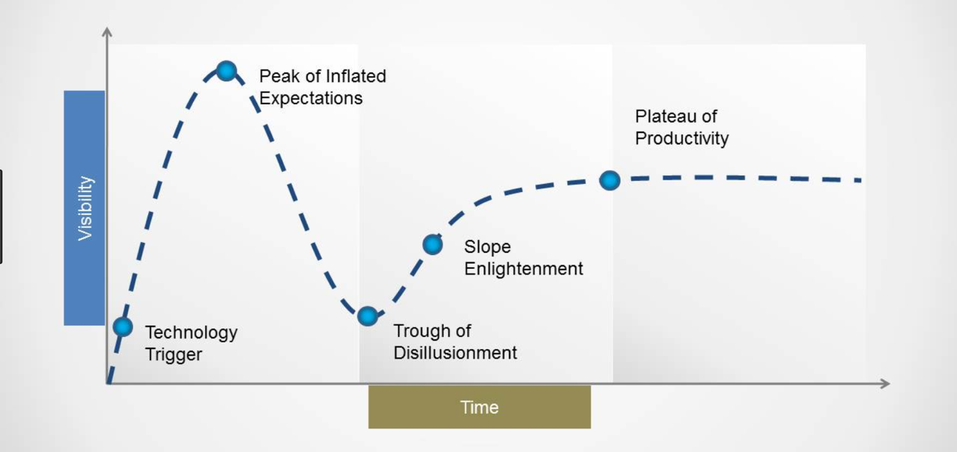
Three key macro analytics trends for consumption (30)

Slide 5
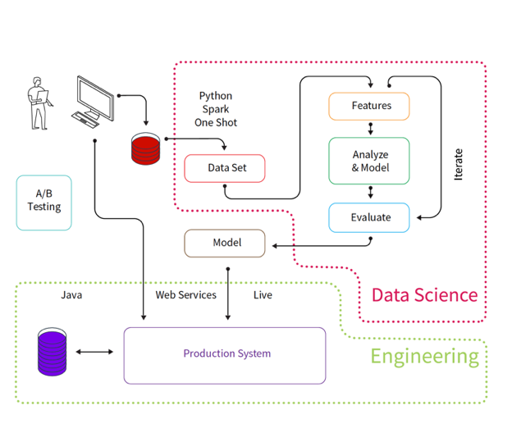
One Shot to Production Analytics/ML/AI Pipelines

Slide 6
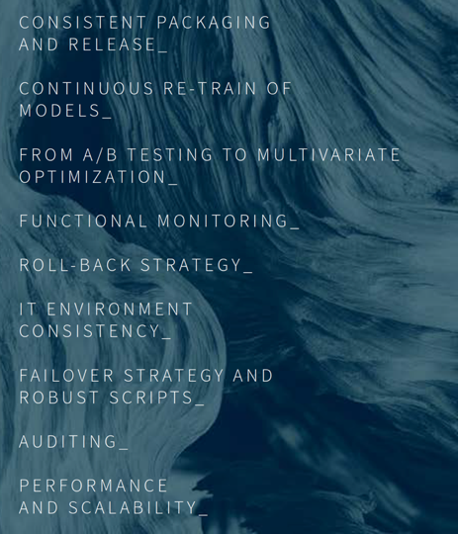
Realization of Intelligent Systems: The Algorithm Becomes a First Class Citizen
ANALYTICS OPS
Analytic Lifecycle Management
“Software” Parallels
Dev, Test, Stage, Production, & Versioning and Release Notes
Continuous Delivery Pipelines
Containers
Microservices
Continuous Analytics performance management
Champion/Challenger
Live Updating / Hot swaps

Slide 7
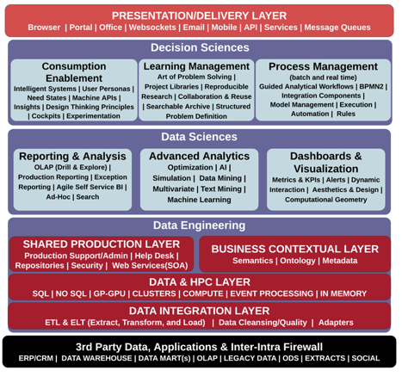
Reference Design Analytics Stack
++ Design
Math + Business
+ Technology
Weak Point for Enterprises Today
In Scaling Decision Sciences
Math + Technology
Technology
Dataset

Slide 8
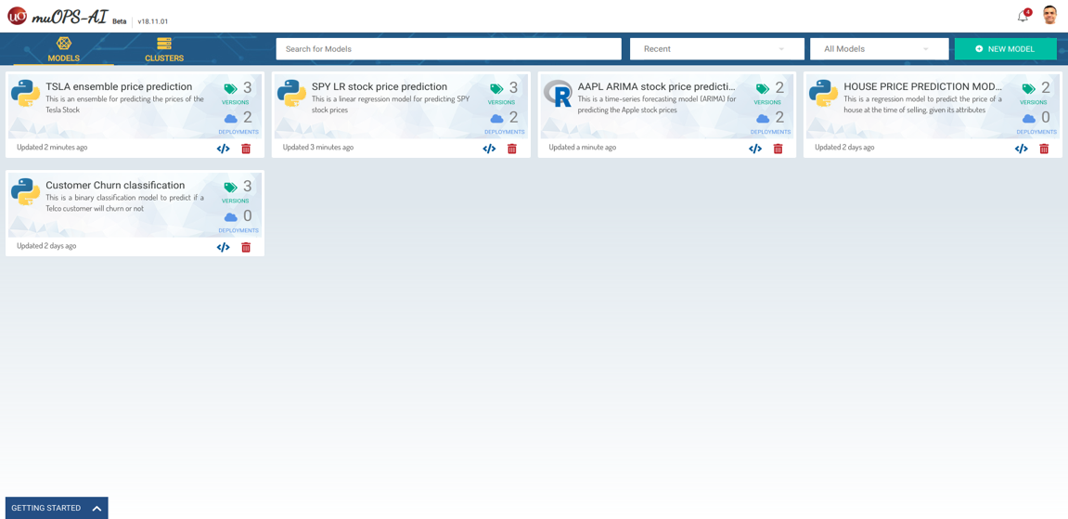
muOPS-AI
Demo App: https://labs.mu-sigma.com/realtime-series/
OPS-AI tool link: https://ird.mu-sigma.com/muops-ai/
Model Operationalization Whitepaper Vendors
muOPS-AI Presales Deck
Click here to access the Demo App
Click here to access the Demo App
Click here to access the Demo App
Click here to access the muOPS-AI tool
Click here to access the Demo App
Click here to access the muOPS-AI tool
Click here to access the muOPS-AI tool
Click here to access the Model Ops Whitepaper
Click here to access the Model Ops Whitepaper
Click here to access the Model Ops Whitepaper

Slide 9
Model ops app link: https://ird.mu-sigma.com/muops-ai/
Username: Demo.User
Password: demouser
(this is running in Bangalore)
Link for the prediction DEMO app: https://labs.mu-sigma.com/realtime-series/
Username: Demo.User
Password: demouser
(this is running in Austin)

