Slide 1
THURSDAY LEARNING HOUR
THURSDAY LEARNING HOUR
Introduction to Knowledge Graphs
Speaker : Prabakaran Chandran
Date: 11 Feb 2021 Location: Zoom Time: 6:00 – 7:00 PM IST

Slide 2
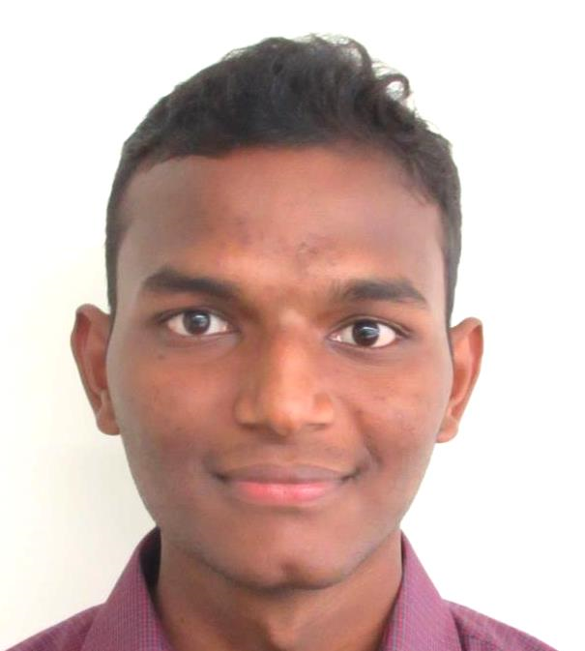
THURSDAY LEARNING HOUR
Introduction to Knowledge Graphs
OUR SPEAKER
Prabakaran Chandran works as a part of the NTT-Data Corporation – Fast Retailing account and has been with Mu Sigma for 1.5 years. He has worked in multiple teams and projects gaining experience in Predictive and Statistical Modelling, Machine Learning, Deep Learning, Computer Vision and NLP. During his free time, he likes to conduct seminars and sessions for college students. He has given 10 free webinar sessions to rural students on AI and Data Science during this pandemic.

